Slide 1

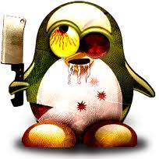
The user’s perspective on processes
1
The user’s perspective on processes

Slide 2
Seeing and understanding processes
2
The user’s perspective on processes

Slide 3

What is a process?
A process is an instance of a program that is running.
It is different from a job, which is the term used when managing process(es) from the shell – though it’s vague!
Jobs won’t be discussed in this lecture ☺
3
Functions

Slide 4




What is a process?
A process can start another process. For example, starting the system may start the graphical environment, which starts the desktop, etc.
Each process has a unique ID named PID.
1251
3467
1196
Process tree
When processes die, their PID can be reassigned; it’s usually delayed.
3245
2368
4
Functions

Slide 5


What is a process?
Processes also belong to a process group (PGID)
Process groups allow the system to keep track of which processes are working together and hence should be managed together
Each group can have a leader, identified by PID = PGID
5
Functions

Slide 6
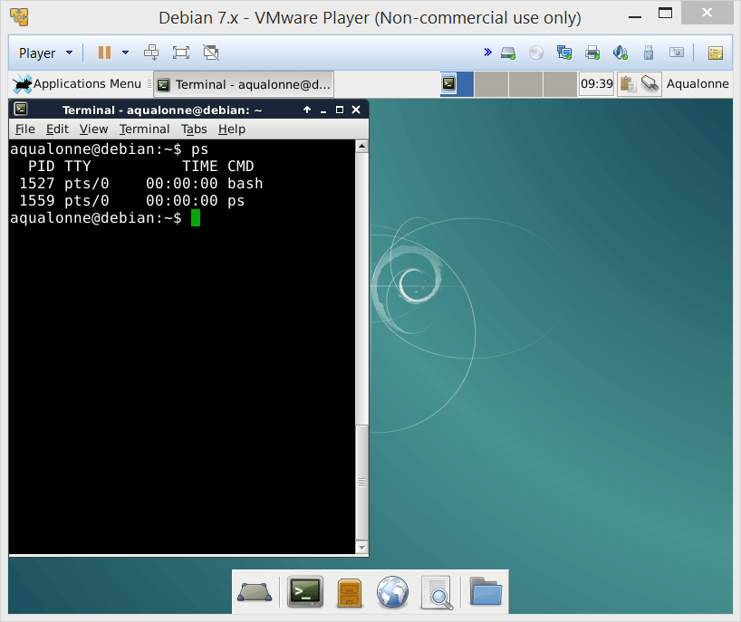
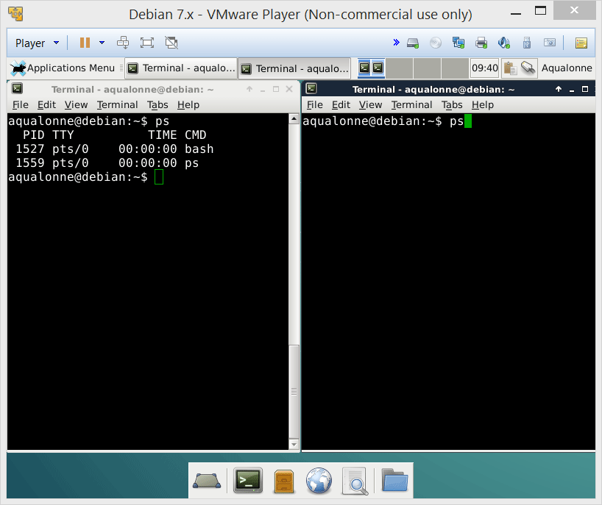
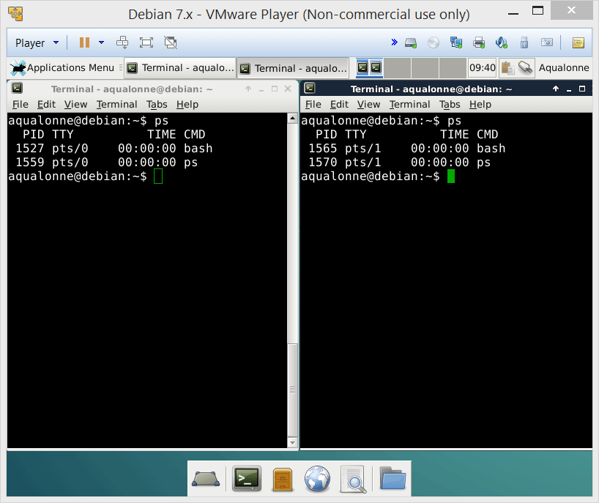
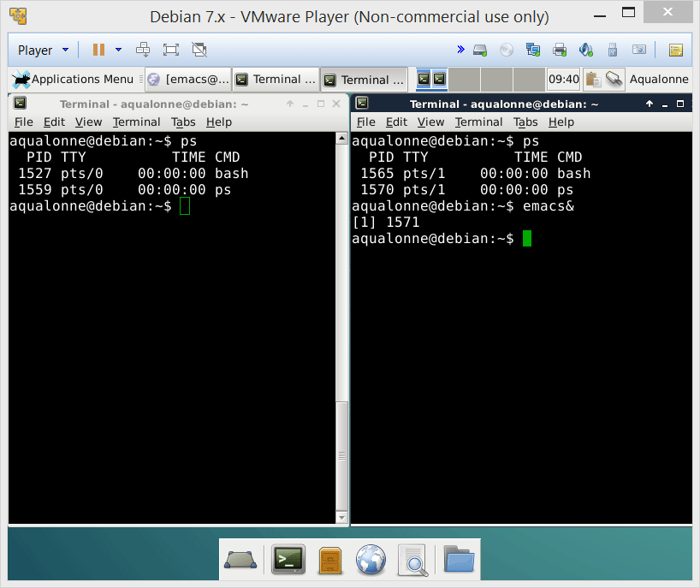
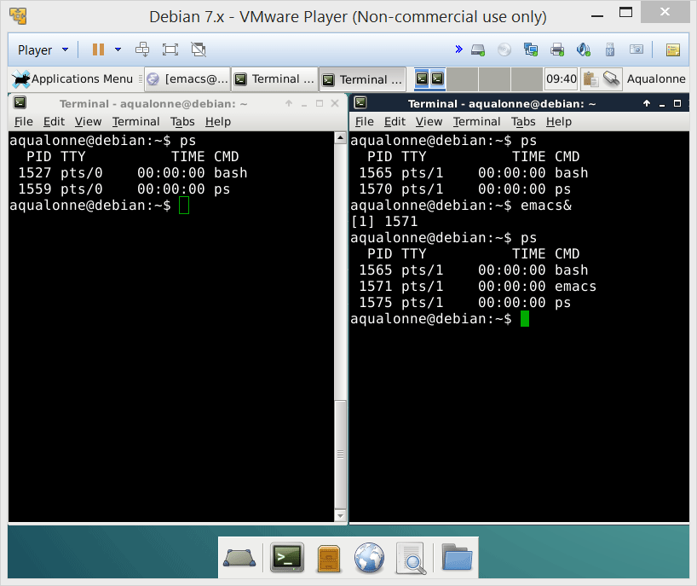
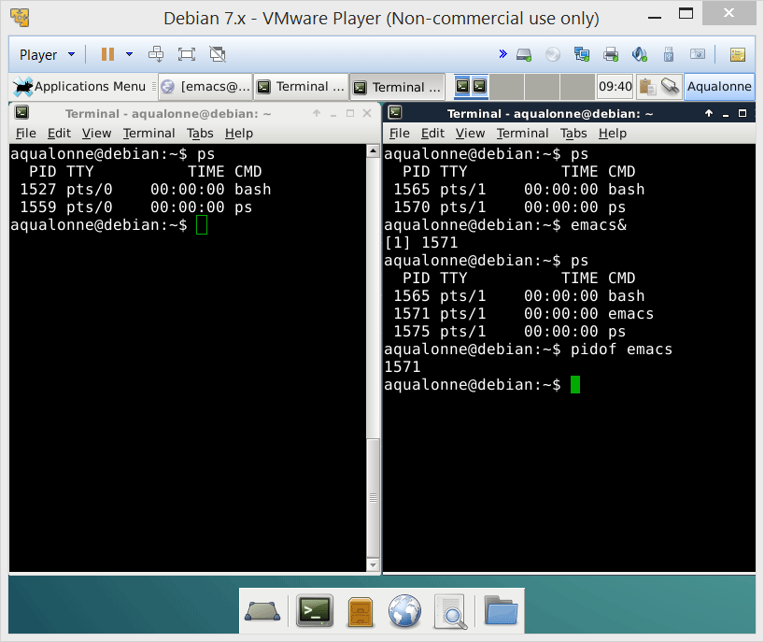
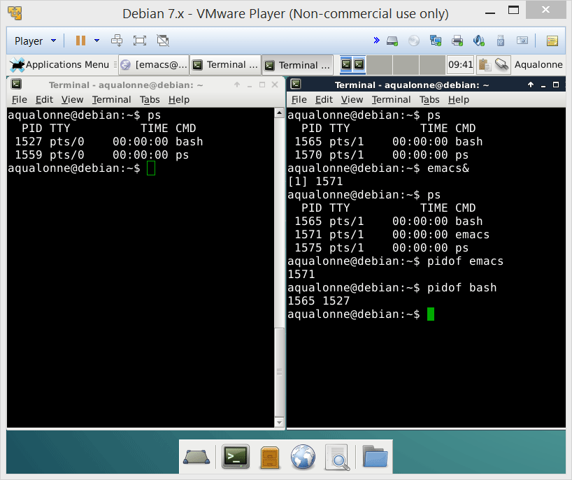

Seeing processes
ps is the quick way to see the processes and their ids
If you know the program’s name and you want to see which processes run it: pidof
You could write a script to know how many processes run a given program ☺
6
The user’s perspective on processes

Slide 7
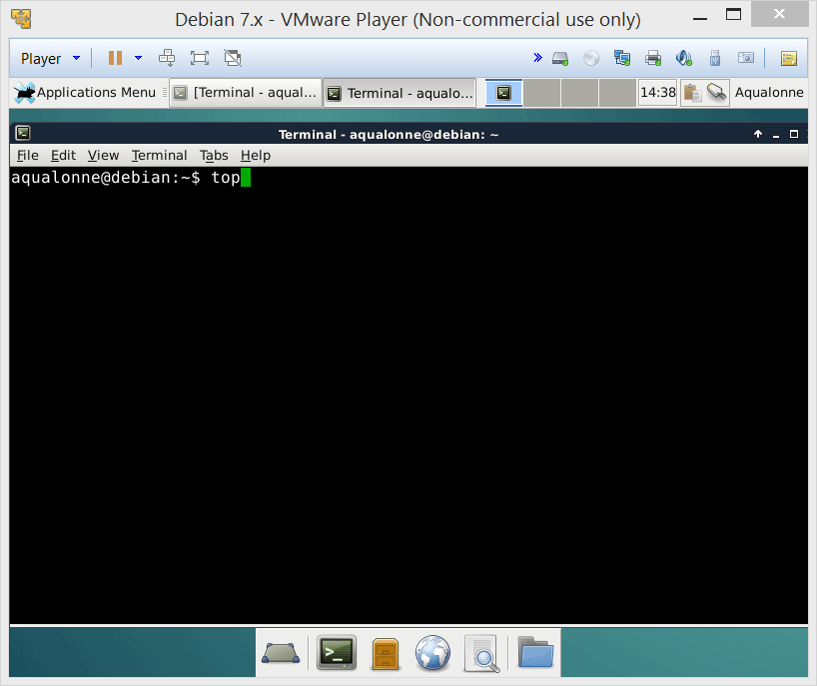
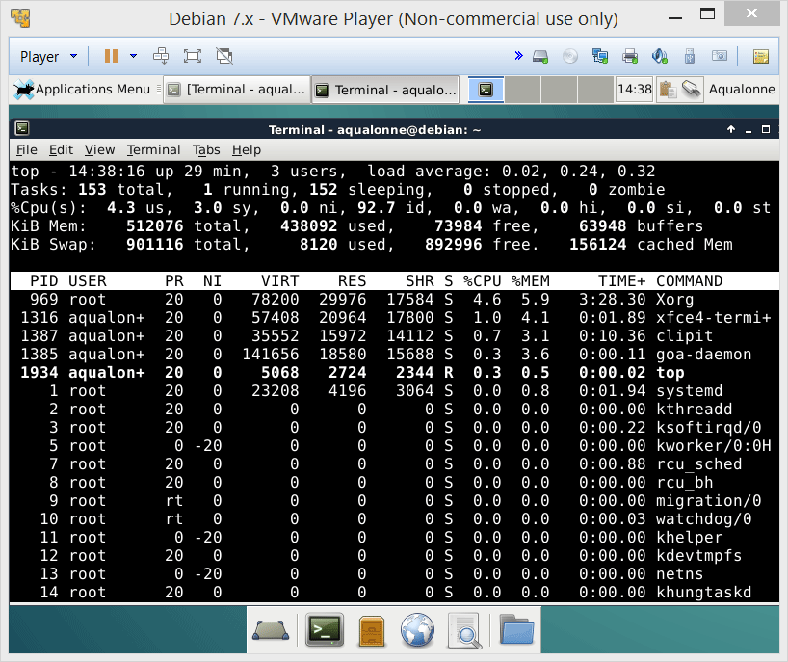
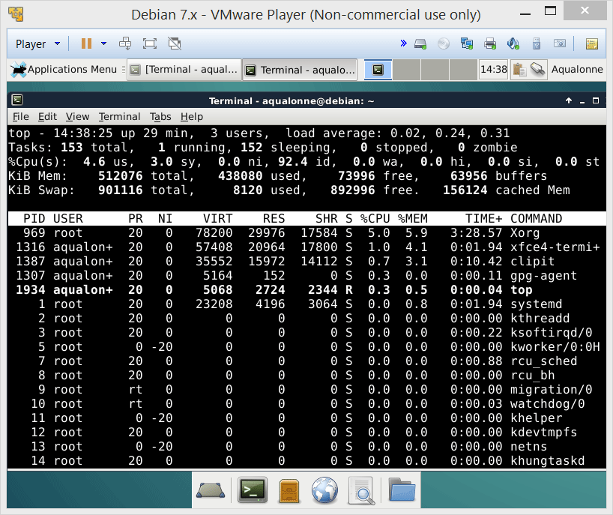
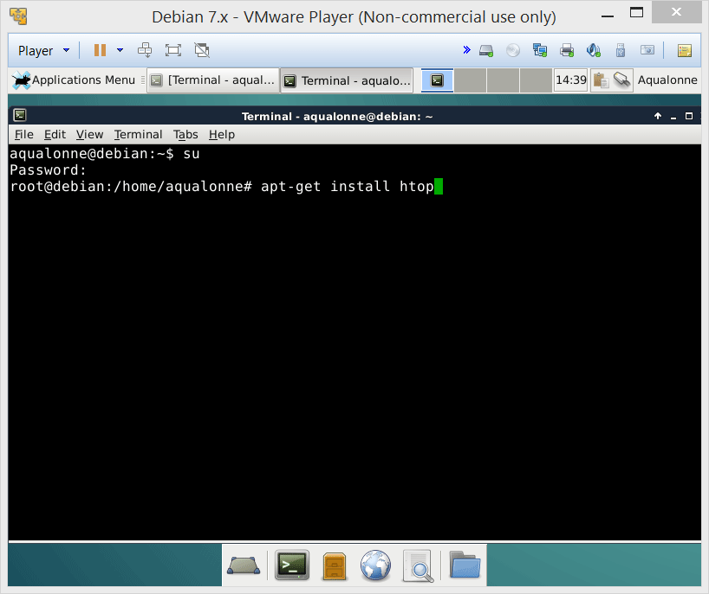
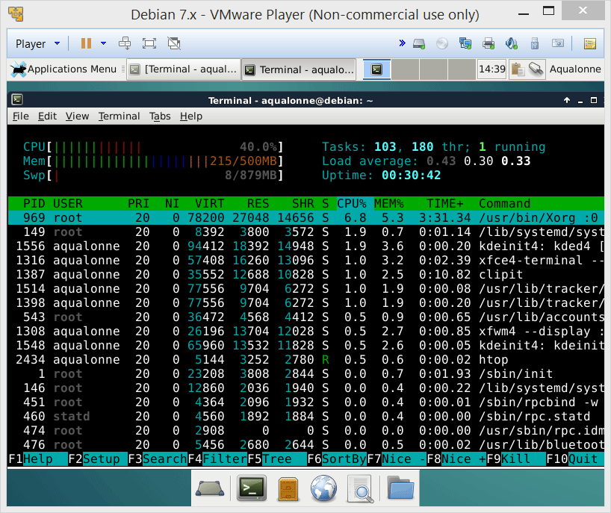
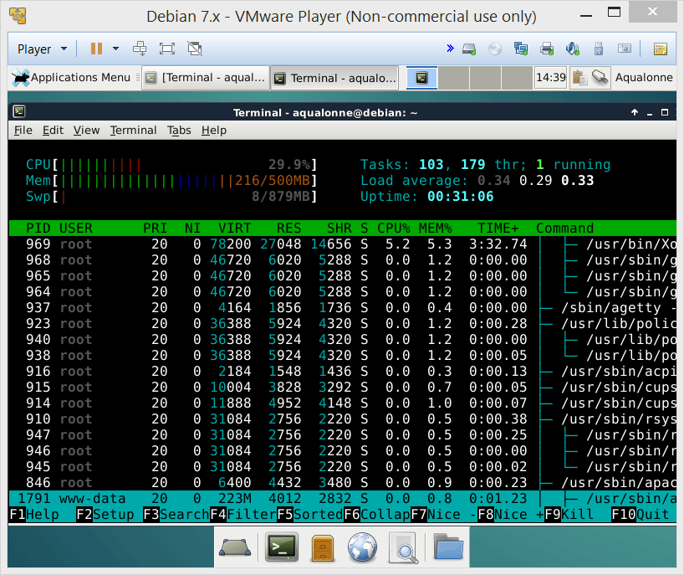
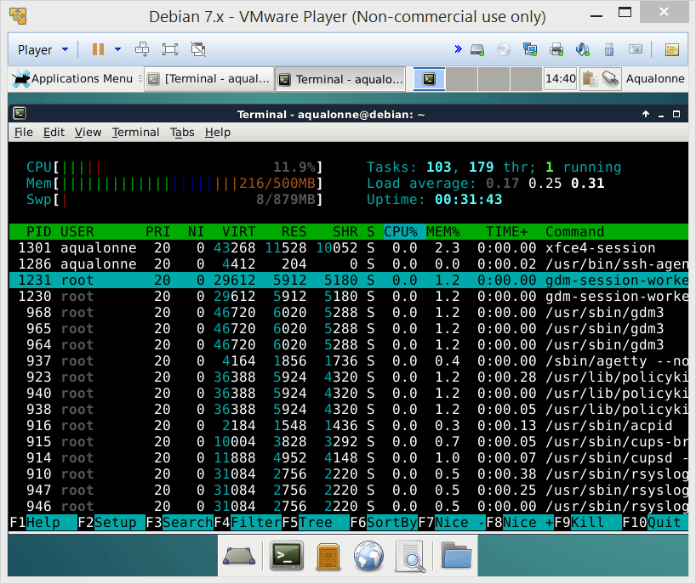
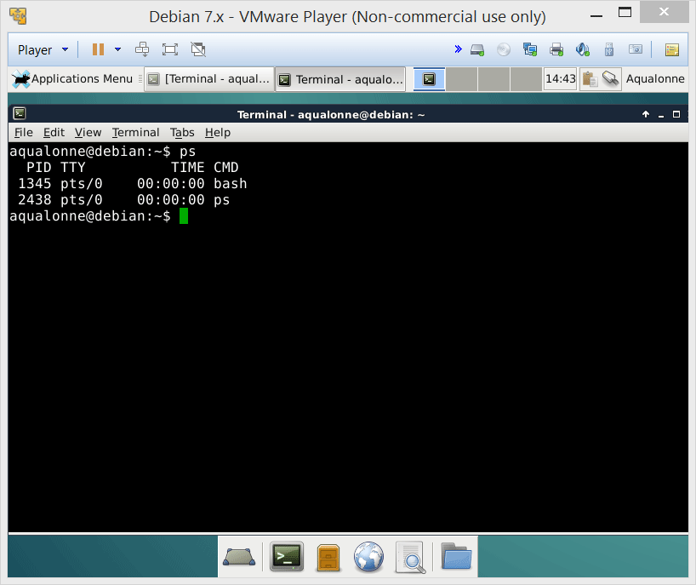
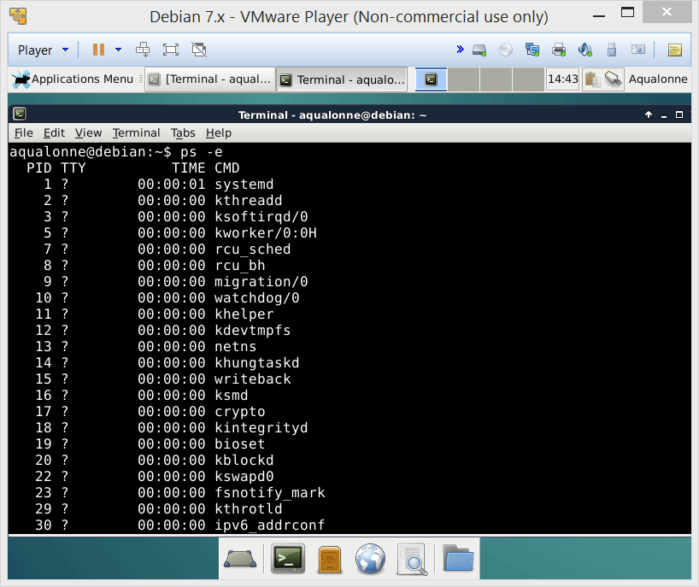
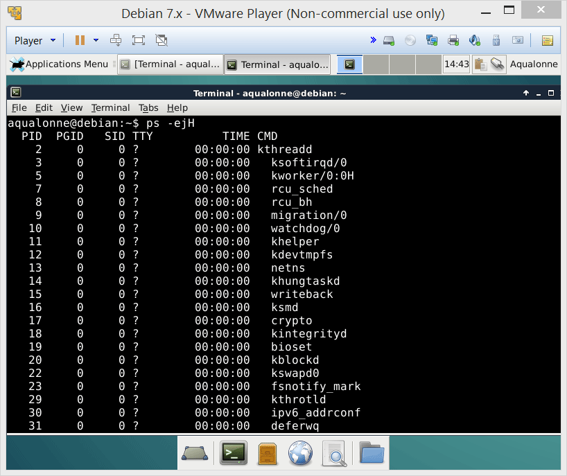
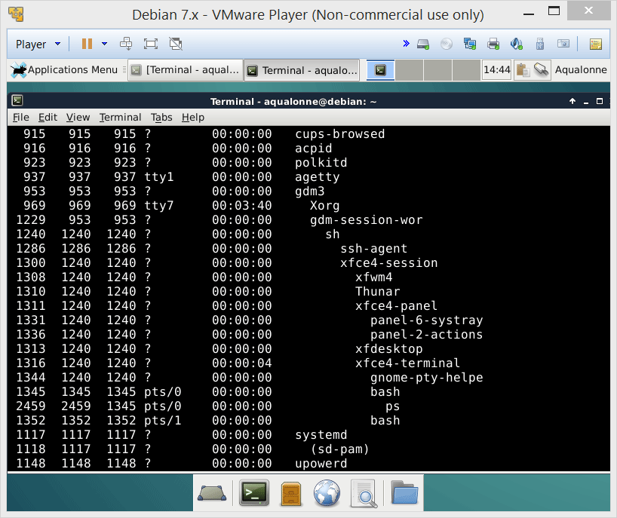
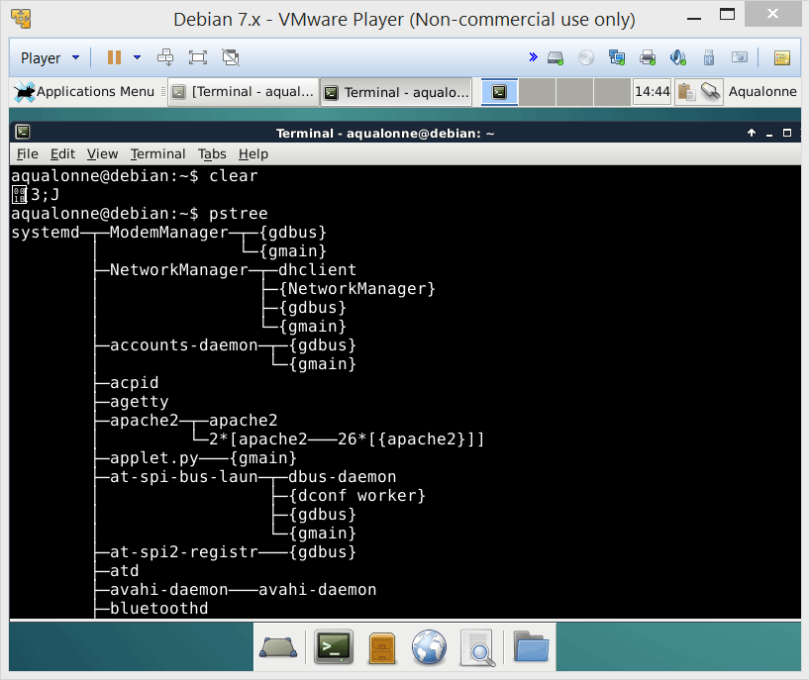
Seeing processes
To see processes and what resources they consume, use top or install htop
If you want to get the processes’ ID and know how they relate, use ps
If you just want to see the process tree, use pstree
7
The user’s perspective on processes

Slide 8
Communicating with processes via signals
8
The user’s perspective on processes

Slide 9

Signals
Signals all start with SIG
One way to communicate with processes is to send signals.
stop
suspend
stop & report
9
The user’s perspective on processes

Slide 10
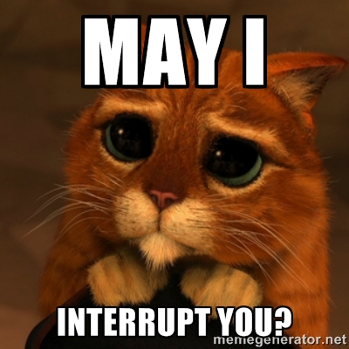
Signals
SIGINT
Generated when you type Ctrl+C
You’re asking the process to please be interrupted. But it may ignore you.
10
The user’s perspective on processes

Slide 11
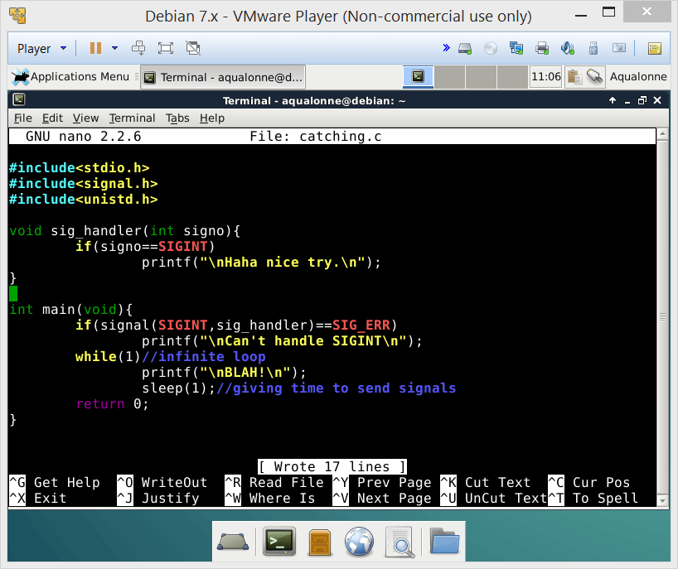
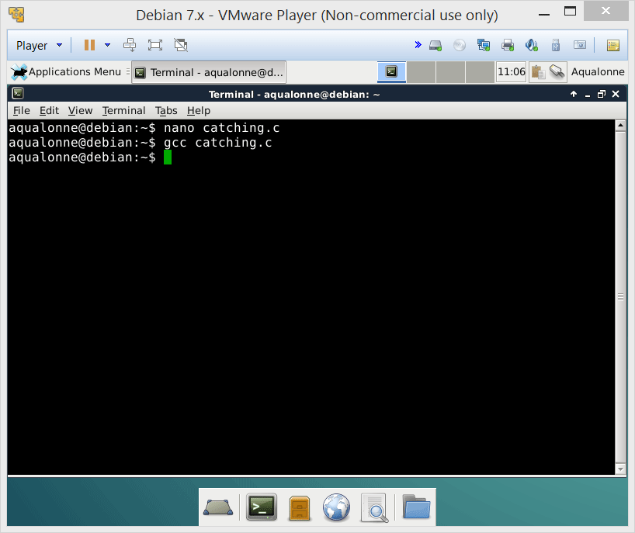
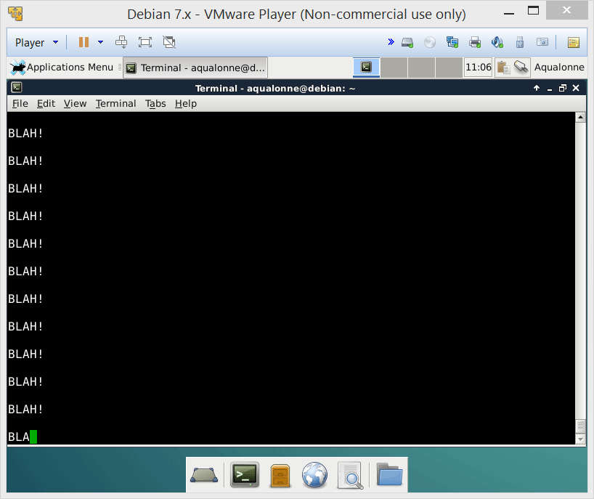
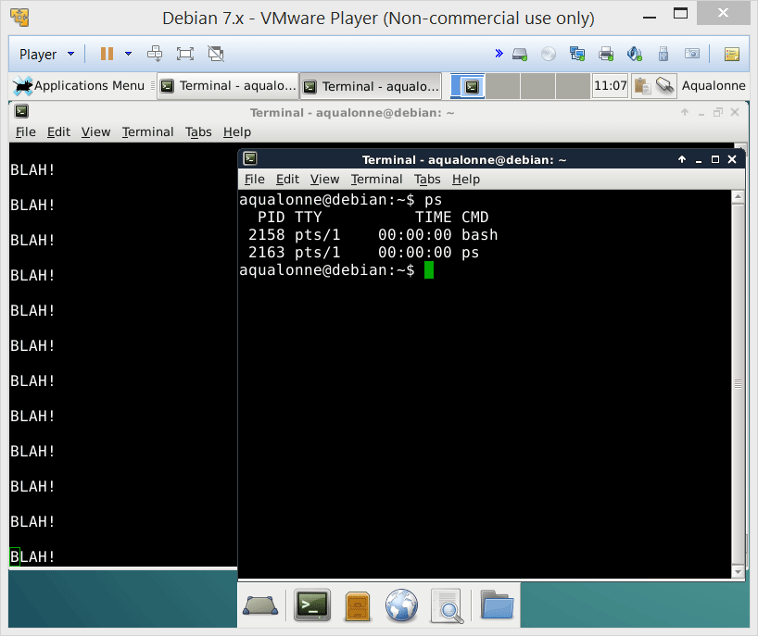
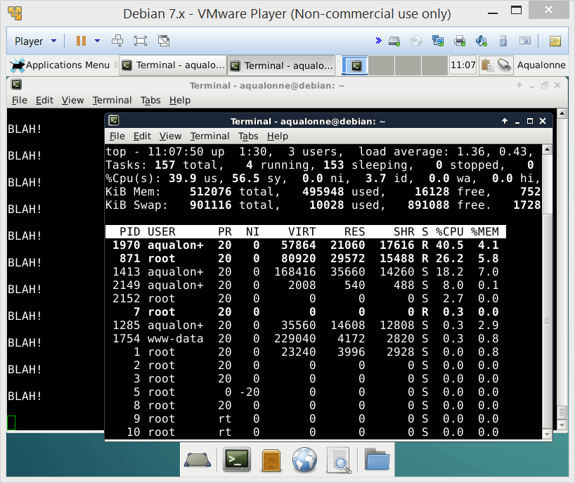

Signals
A program can catch a SIGINT and handle it as it feels like.
To stop it, find its pid and send it a stronger signal...
11
The user’s perspective on processes

Slide 12
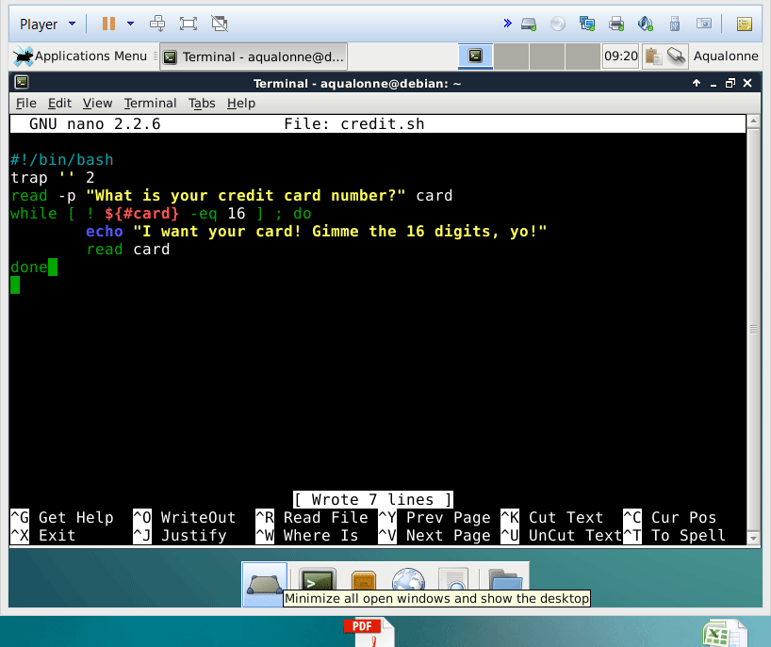
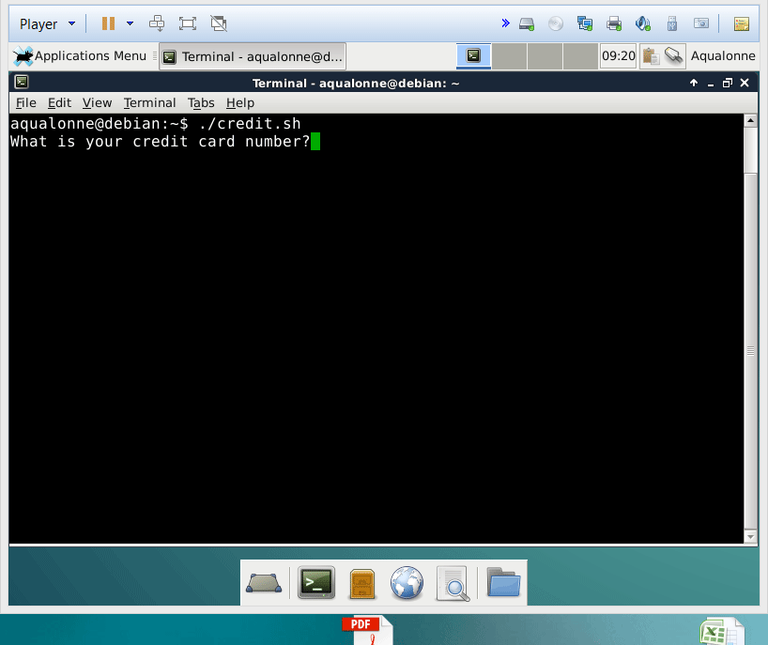
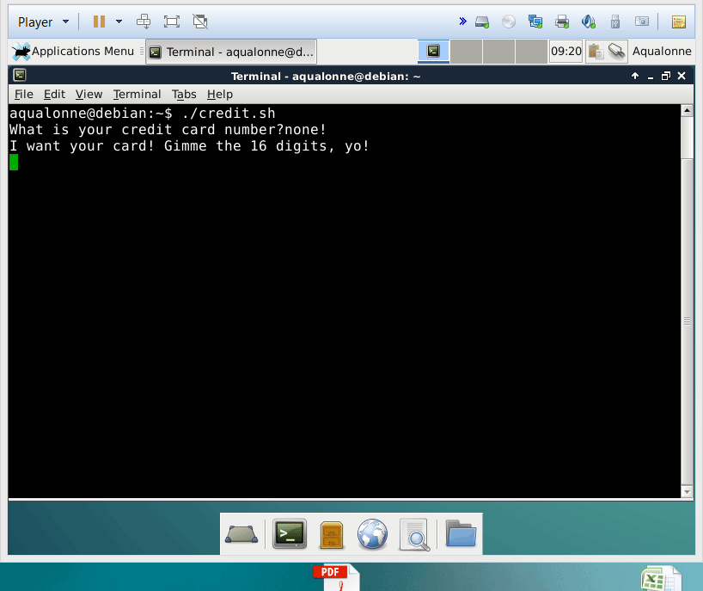
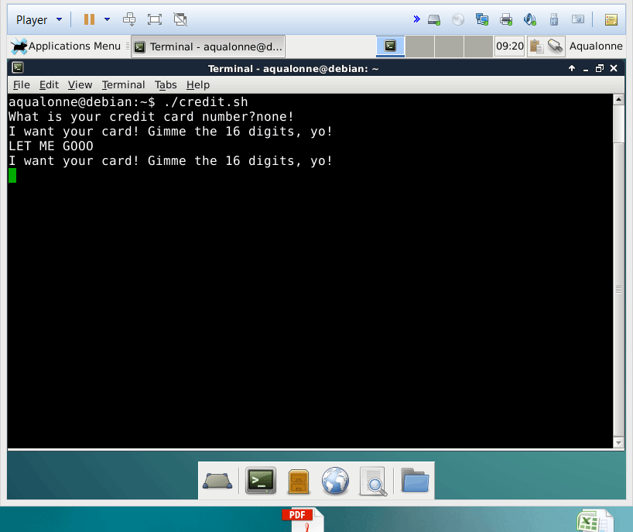
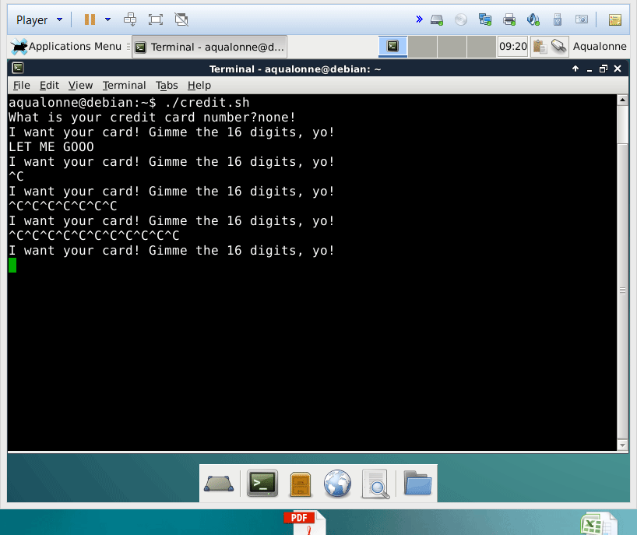
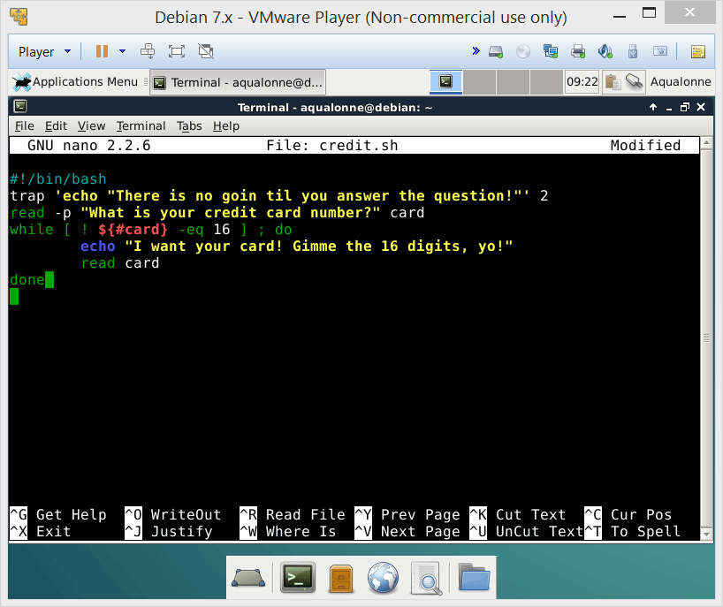
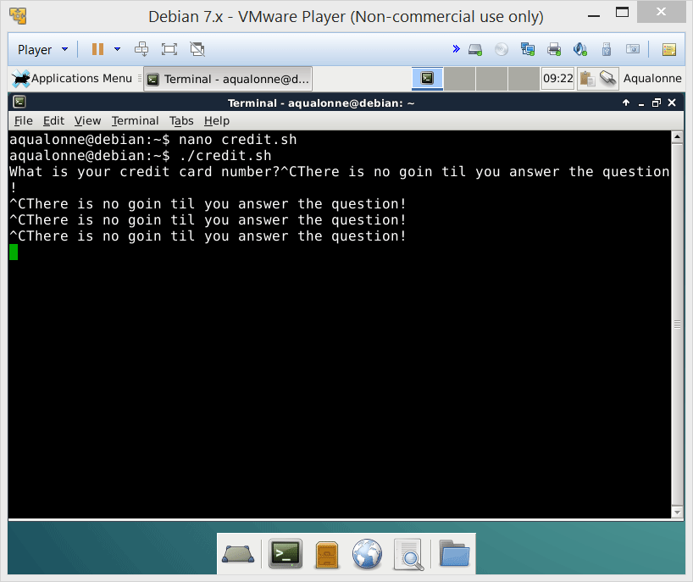
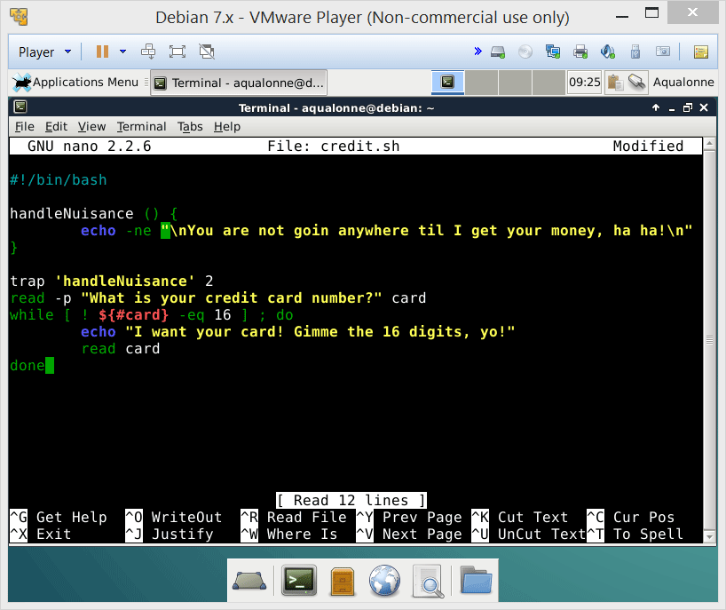
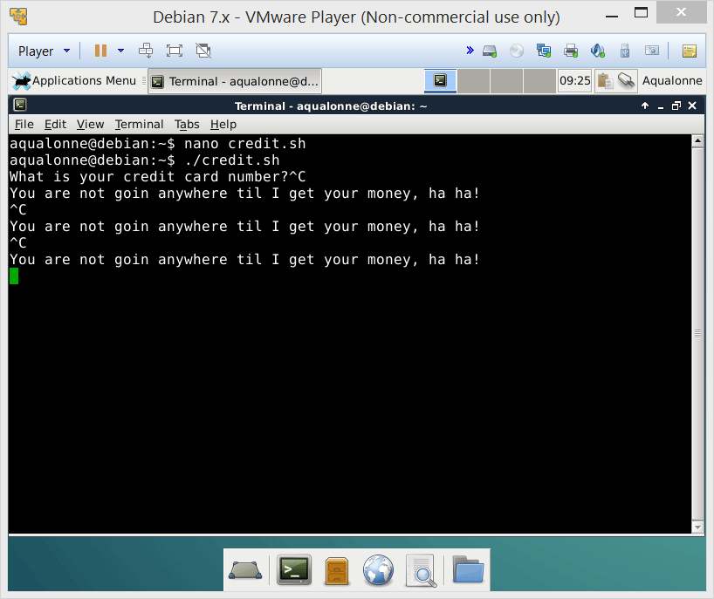
Signals
In Bash, the trap command lets you do your own actions when a certain signal is received.
Your actions can be anything, such as a set of commands or calling a function.
The signal is specified by code
SIGINT
SIGQUIT
SIGKILL
20 SIGSTP
12
The user’s perspective on processes

Slide 13



Signals
SIGKILL
This signal cannot be caught or ignored.
SIGINT vs SIGKILL
13
The user’s perspective on processes

Slide 14
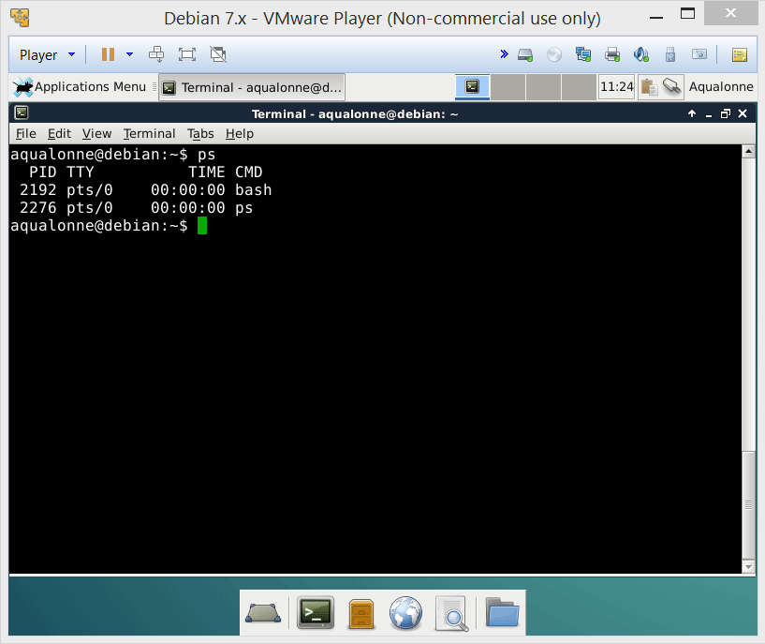
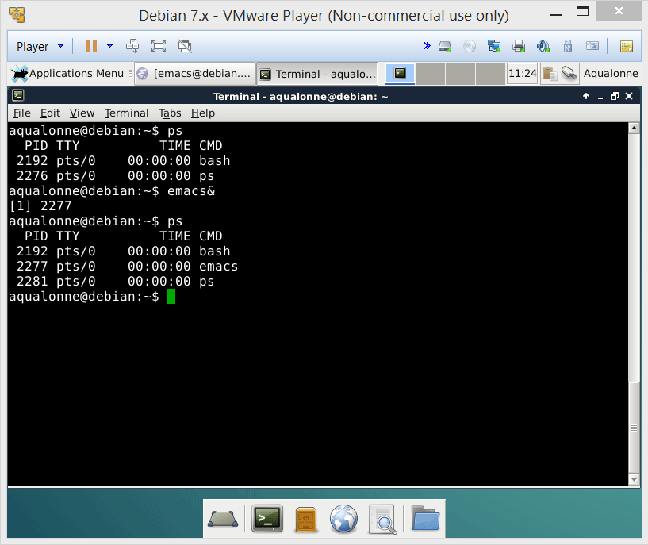
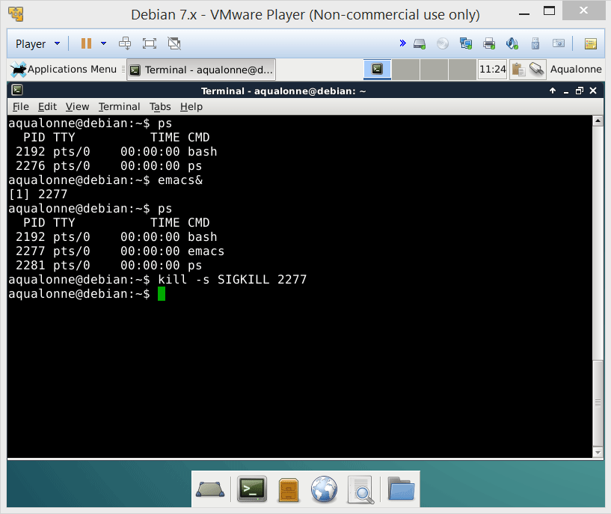
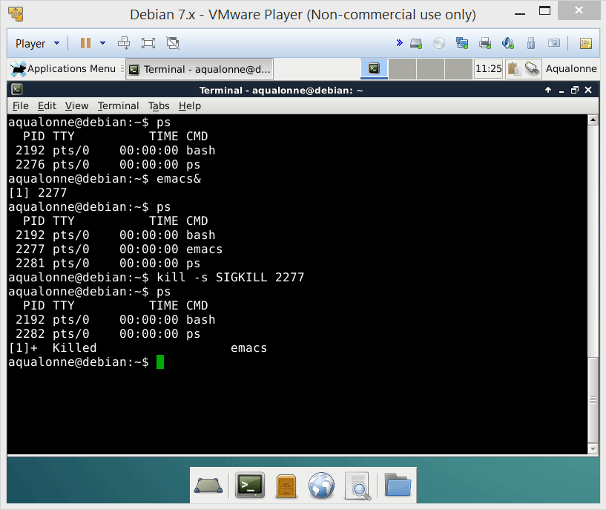
Signals
To send a specific signal to a process, use
kill –s SIG..... PID
It does not mean that you want to kill the process. It’s just the command’s name...
If you want to terminate a process go straight for SIGKILL, not SIGINT.
14
The user’s perspective on processes

Slide 15

Signals
When it comes to killing, there are several commands, each with its own style...
sends to all PIDs that run a command looking like...
pkill
killall
kill
xkill
sends to a PID
sends to a window
sends to a all PIDs running a command
15
The user’s perspective on processes

Slide 16
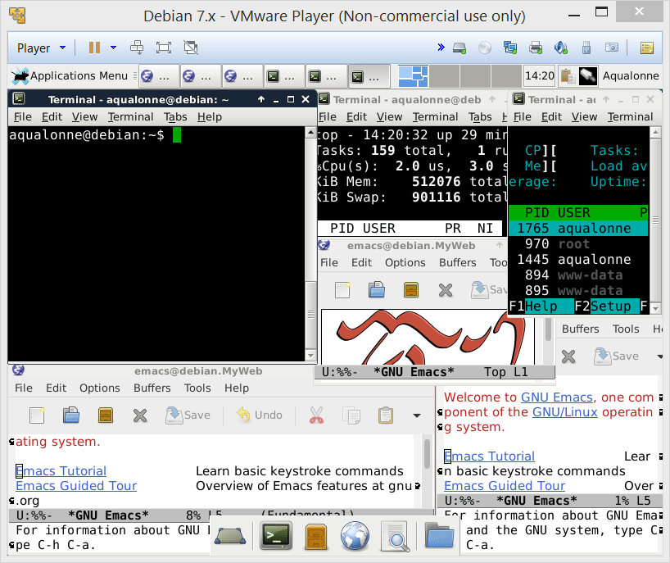
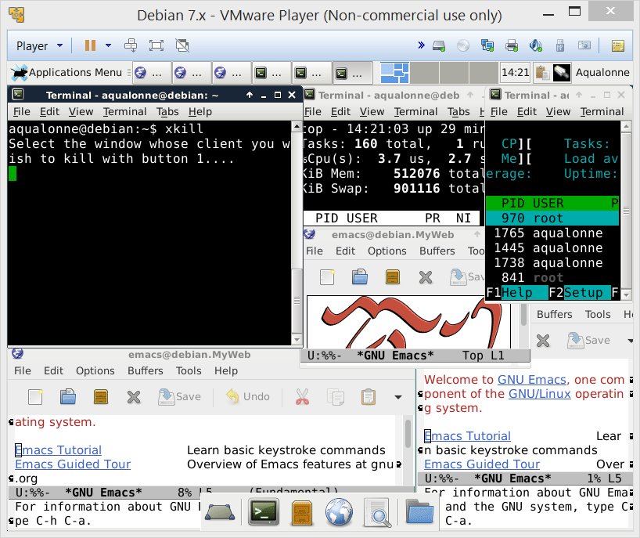
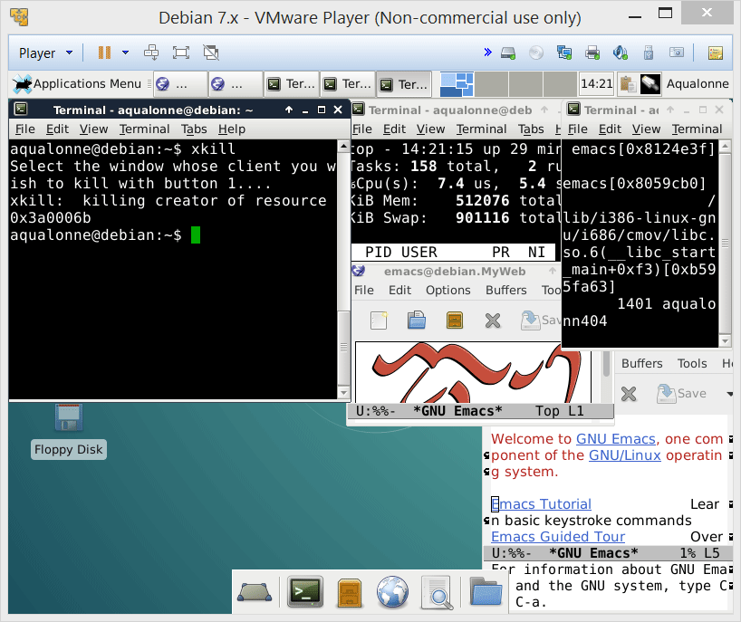
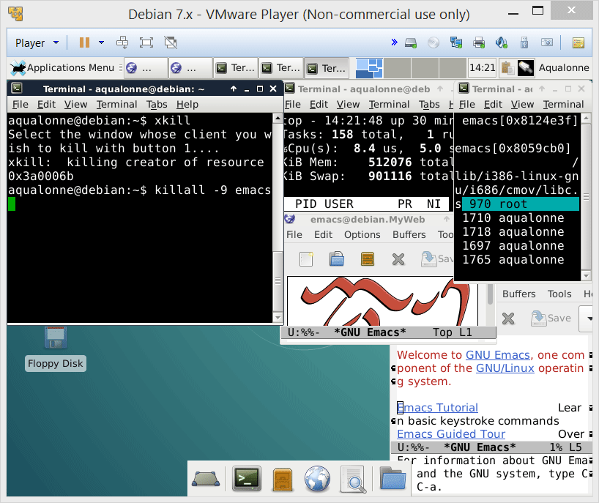
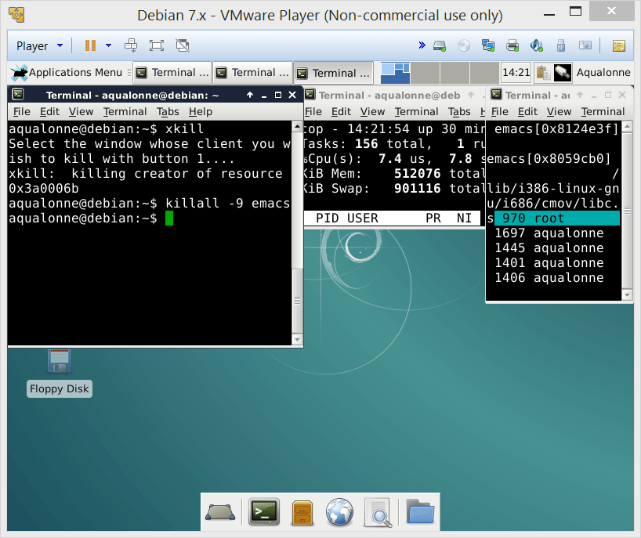
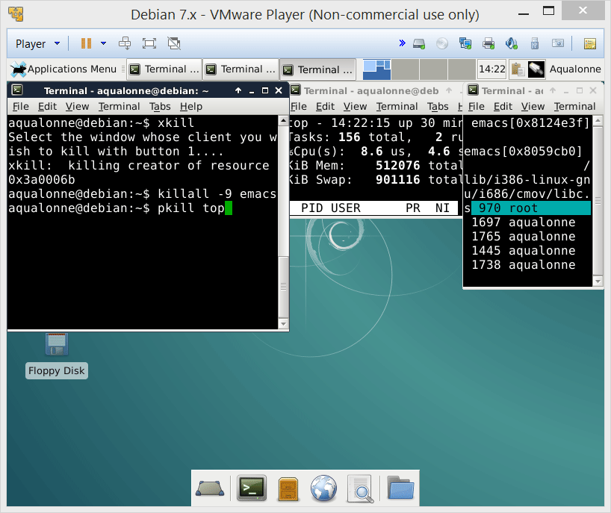
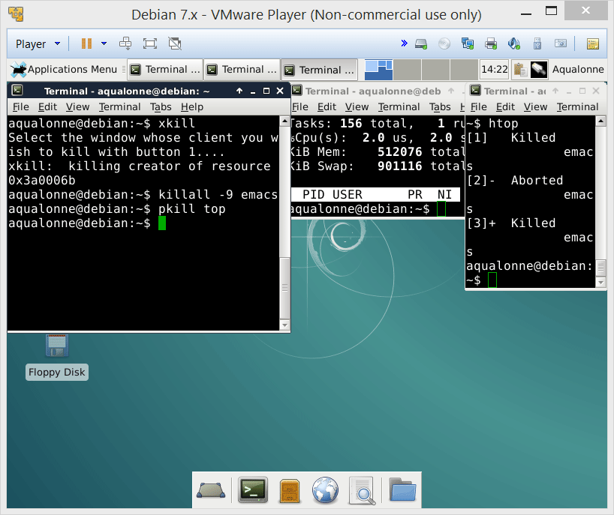
Signals
xkill is very convenient to just ‘murder on touch’
killall can send a signal to multiple instances
pkill is a pretty stupid thing to do...
16
The user’s perspective on processes

Slide 17

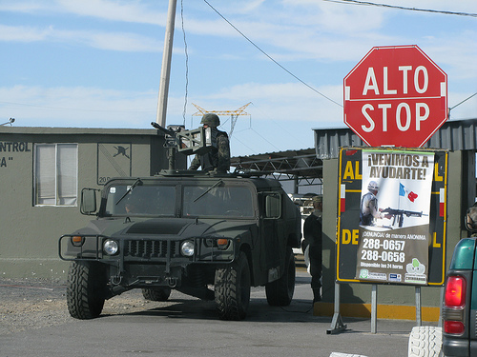
Signals
SIGSTP
SIGSTOP
Politely asking a process if it feels like stopping a bit
Asking less politely
SIGCONT
Make the process continue
17
The user’s perspective on processes

Slide 18
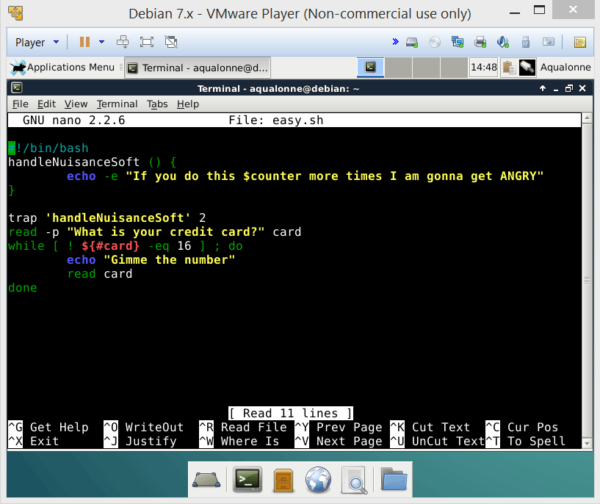
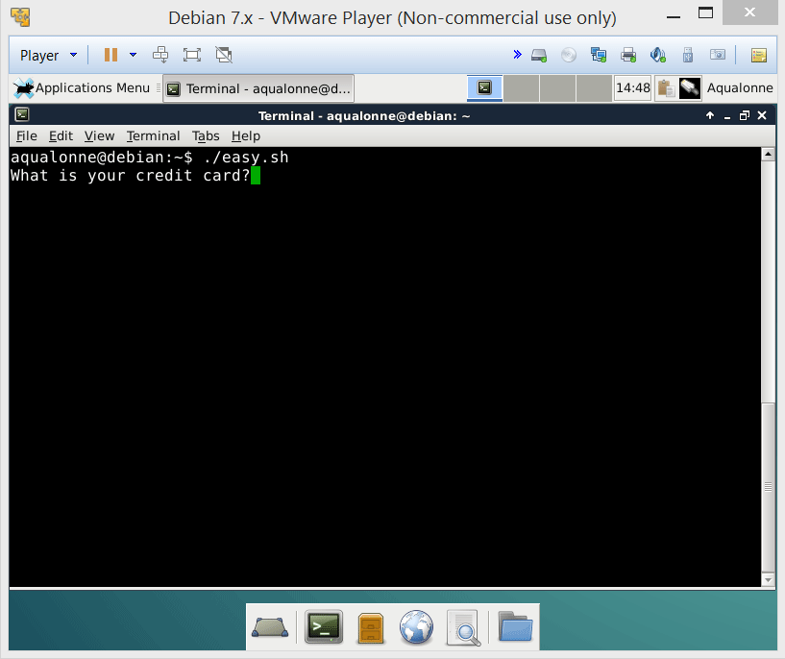
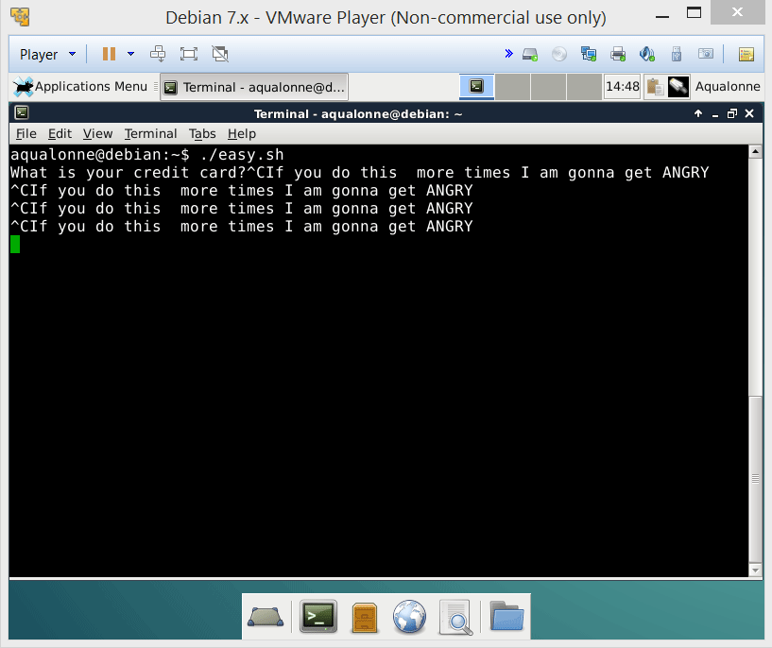




Signals
If Ctrl+C doesn’t close, you can try Ctrl+Z to knock it out temporarily
Then you can finish it off by hand
18
The user’s perspective on processes

Slide 19













Signals
19
The user’s perspective on processes

Slide 20



Signals
To know whether a process was stopped, you need to look at its state.
ps -o pid,state
what output?
T means it’s stopped
https://idea.popcount.org/2012-12-11-linux-process-states/
20
The user’s perspective on processes

Slide 21





Signals
Signals can come from multiple sources.
CPU
Memory
SIGXCPU (exceeds allocated CPU time)
SIGSEGV
(segmentation fault)
SIGKILL
SIGSTOP
SIGINT (Ctrl C)
SIGCONT
SIGQUIT (Ctrl \)
Process
Terminal driver
Shell
Can also send signals to itself, even if signals are primarily to communicate with a process.
21
The user’s perspective on processes

Slide 22

Signals
In this code, we give ourselves 10 seconds to read a file. If we fail to do it in that time we stop reading.
It’s typical to use alarms to create an upper time limit on operations that can time out.
A tutorial on setting alarms:
http://www.usna.edu/Users/cs/aviv/classes/ic221/s14/lec/17/lec.html
22
The user’s perspective on processes

Slide 23




Signals
The list of all signals and what they mean can be found in a C header file.
The name of THIS folder depends on what system you run. For others it may be e.g. x86_64-linux-gnu
For example, this shows that SIGSTOP is unblockable, whereas SIGSTP is the one emitted by the keyboard (Ctrl+Z) and can be blocked/ignored.
23
The user’s perspective on processes

Slide 24
Managing processes
24
The user’s perspective on processes

Slide 25

Detaching processes
When there is something in the foreground, it takes all your attention
Stuff in the background still exists! It’s just not grabbing your attention.
25
The user’s perspective on processes

Slide 26













Detaching processes
A script normally runs in the foreground and takes all of your attention.
When you use &, it will make it run in the background. You can check what runs via jobs
Since it’s in the background, you can’t do Ctrl+C to stop it anymore... kill is the only way you can send it a signal.
26
The user’s perspective on processes

Slide 27



Detaching processes
How would you run this program in the background?
& will let it ‘run’ in the background while polluting you with the output!
27
The user’s perspective on processes

Slide 28

Detaching processes
nohup separates the process from the terminal: no more standard input, and outputs are redirected.
It’s different from &: the process doesn’t read input and the Shell isn’t waiting for it to finish before giving you the prompt back.
28
The user’s perspective on processes

Slide 29









Detaching processes
One way to make a process run really independently is:
nohup ...program...
to detach from shell
Ctrl+Z
to pause (goes background)
bg ...job number...
to run in the background
kill -9 ...job number...
to end, if it doesn’t end itself
If you don’t want the output to be appended, then redirect it!!
29
The user’s perspective on processes

Slide 30

Detaching processes
To go further on processes, you can check out these 2 commands:
fg
disown
30
The user’s perspective on processes

Slide 31
Process priority level
Several processes are always asking for CPU resources.
Process 1
It might look like they are running in parallel: you’re listening to music while browsing the web and, and, and...
Process 2
CPU
But on each processor, processes have to run sequentially.
Process 3
There are many possible sequences!
31
The user’s perspective on processes

Slide 32

Process priority level
If you want to know more about the different sequences for processes, read Scheduling (computing) on Wikipedia
We are not going to talk about how the computer automatically orders processes.
We will talk about how we can, manually, influence the ordering.
32
The user’s perspective on processes

Slide 33











Process priority level
Using nice you can increase or decrease the priority of a process
if you’re admin
33
The user’s perspective on processes

Slide 34

Scheduling processes
34
The user’s perspective on processes

Slide 35



Scheduling processes
You can run a process...
e.g. save the TV show broadcasted when I sleep
...once at a given day and time
at
batch
crontab
...when system load is low
...periodically
e.g. use spare computing power in the office to crunch data
e.g. backup the system every first Monday of the month
35
The user’s perspective on processes

Slide 36
Scheduling processes
For periodic schedule via crontab, there is a control file.
Minute Hour Day Month Weekday Command
0-59
0-23
1-31
1-12
1-7
Anything
(Monday is 1)
Every Monday at 8am
0 8 * * 1 echo Happy Monday Morning
Every Monday at 2:30pm
30 14 * * 1 echo Meeting coming at 3pm
Every Friday at 5pm
0 17 * * 5 $HOME/bin/cleanup.sh
36
The user’s perspective on processes

Slide 37












Scheduling processes
To list your currently scheduled processes:
crontab –l
If you’re admin, to list the schedule of a user:
crontab –u user –l
To edit a crontab: -e
37
The user’s perspective on processes

Slide 38
Scheduling processes
To schedule something once, use at timeDate command
You don’t need to be logged in for the command to run! And it can email you results too.
% at 1345 Wed
% at 0145 pm Wed
% at 0925 am Sep 18
% at 11:00 pm tomorrow
% at 0930 pm today
% at teatime
% at now + 5 minutes
38
The user’s perspective on processes

Slide 39





Scheduling processes
Ctrl+D is how you stop entering the commands
To work, the at command needs the at service. If it’s not on, you can start it via
/etc/init.d/atd start
If you need to computer to start at a specific time, then use rtcwake
39
The user’s perspective on processes

Slide 40


Scheduling processes
You can use at in a script by putting several lines of commands to run within
<<ENDMARKER
...lines of commands...
...lines of commands...
ENDMARKER
40
The user’s perspective on processes

Slide 41
Practice questions
41
The user’s perspective on processes

Slide 42
What command do I use in a script to catch a signal?
trap
Using trap, I can catch any signal and avoid having the program closed because of it. True or False?
False
What can’t be trapped?
SIGKILL and SIGSTP
Using the command kill serves to kill any program.
False – it’s to send a signal. Some can be ‘deadly’ but they don’t have to.
42
The user’s perspective on processes

Slide 43
How can I detach a process so it doesn’t read the shell input?
&
How can I detach a process so it doesn’t read input or doesn’t display output?
nohup
How do you use crontab?
Use crontab –e to edit the control file, where each line goes as:
Minute Hour Day Month Weekday Command
What’s batch for?
Run a process when the load is low.
43
The user’s perspective on processes

Slide 44

John is trying to cut on his British diet for the week. On Monday, at tea time, the computer should show tell him "you're allowed 5 cups of tea". The next day, same time, he would be allowed 4 cups; then 3 cups the next day, etc. When he can't drink tea, the computer shows the message "No tea today". Write a script diet.sh that schedules all these messages to be displayed.
now + 5 minutes
44
The user’s perspective on processes

Slide 45

Ctrl+C is a SIGINT, 2
Write a script ghost.sh. When the user closes the script (using Ctrl+C), the script closes but the user will see the message "I am still in your Shell" in the shell 5, 10, and 15 minutes later.
In words (don't write a script!), clearly explain how to get rid of such a "ghost in the shell".
45
The user’s perspective on processes

Slide 46
John is a system administrator. He works remotely and charges by the hour. The customer doesn't understand John's job. So John takes a few minutes to write a file named jobToDo, containing all the lines that he'd normally have to enter in the Shell for his job. Then, he writes a script doMyJob.sh that schedules all the lines to be run, waiting for 5 minutes between each line. So for example, the first line runs now, 5 mins later the next line will run, etc. John wants to start the script and go play at the Casino while charging the customer for 5 hours worth of work.
Write the script doMyJob.sh to help John enjoy life. To run a line, give it as argument to exec.
46
The user’s perspective on processes

Slide 47

47
The user’s perspective on processes

Slide 48

Short practice questions & activities
We recommend that you do these, but that’s for your own good, not graded.
Write a script to know how many processes run a given command.
Write a script massMurder that implements the killall command. It takes as argument the signal as number, followed by the command.
Imagine that someone wrote a malicious program on your computer which records everything you type, such that it can later search for credit cards numbers of passwords. How would you find whether such a program is running?
Schedule a few tasks using at, look at them and remove them.
Schedule a few birthdays using crontab.
48
The user’s perspective on processes

